Slide 1
Chapter 11: Inter-Integrated Circuit Interface
The PIC18 Microcontroller
Han-Way Huang
Minnesota State University, Mankato
June 2004

Slide 2
The I²C Protocol
Developed by Philips in late 1980s
Current version is 2.0 and supports the following features
1. 100Kbps (standard mode), 400 Kbps (fast mode), and 3.4 Mbps (high-speed mode) baud rate
2. 7-bit and 10-bit addressing
3. Slope control to improve electromagnetic compatibility
Characteristic if I²C Protocol
Synchronous in nature
Master-slave model
Bi-directional data transfer
Serial Interface method

Slide 3
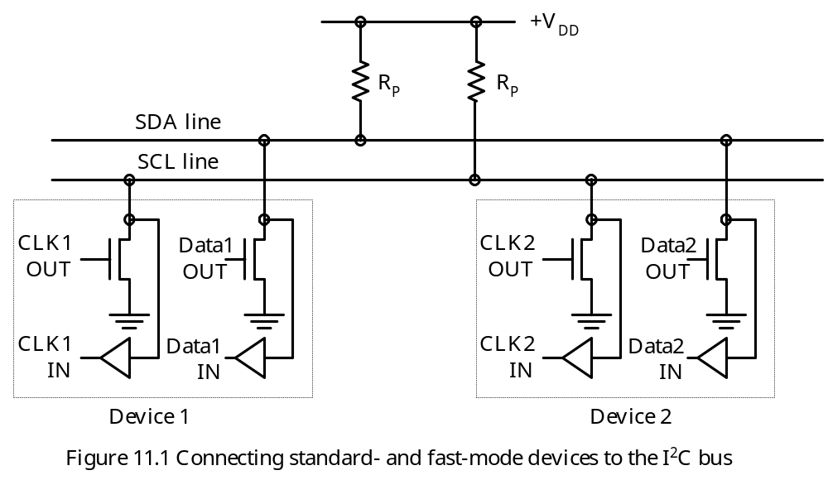
I²C Signal Levels
Two possible electrical states: float high and driven low
Two bus signals: SDA and SCL
Both master and slave devices drives the I²C bus using an open-drain driver.
Bus driver circuit shown in Figure 11.1
Recommended values for pull-up resistors are 2.2 KΩ and 1 KΩ for standard- and fast-mode.

Slide 4
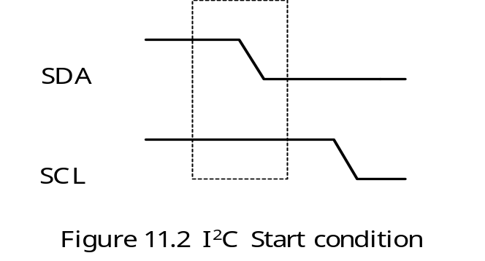
I2C Data Transfer Signal Components
1. Start (S)
2. Stop (P)
3. Repeated Start (R)
4. Data
5. Acknowledge (A)
Start (S) Condition
Indicating that a device wants to transfer data
Represented by the SDA signal going low when the SCL signal is high

Slide 5
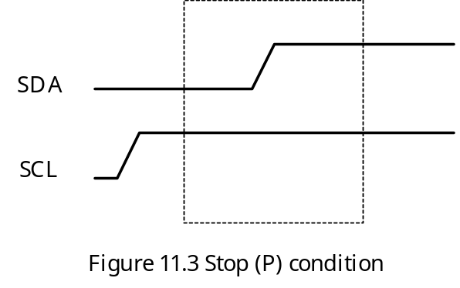
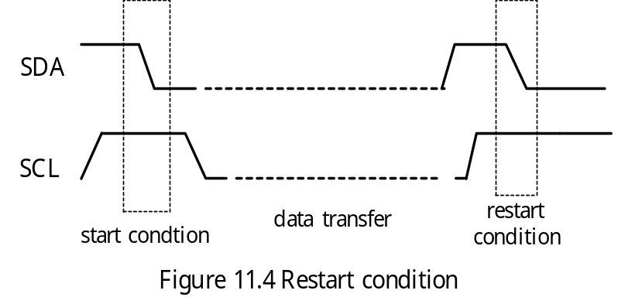
Stop (P) Condition
Indicating a device wants to release the I²C bus
Represented by the SDA signal going high when the clock signal SCL is high
Repeated Start (R) Condition
A start signal generated without first generating a stop signal to terminate the previous communication.
Used by the master device to change data transfer direction in the current communication or to communicate with different slave

Slide 6
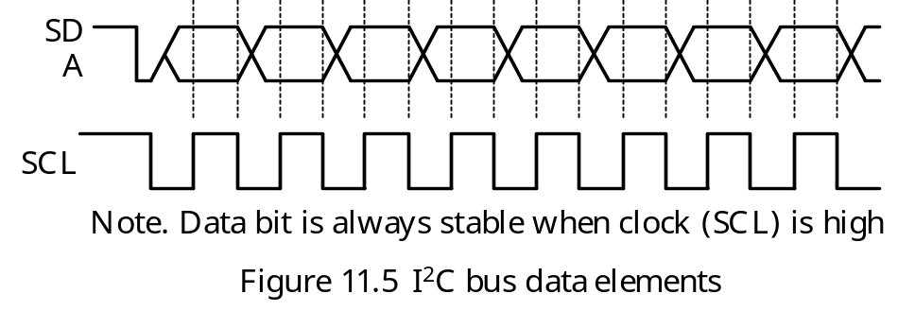
Data
Each data block consists of 8 bits of data.
Data is carried on the SDA line whereas clock pulses are carries on the SCL line.
Data is sampled when SCL is high
Data can change when SCL is low

Slide 7
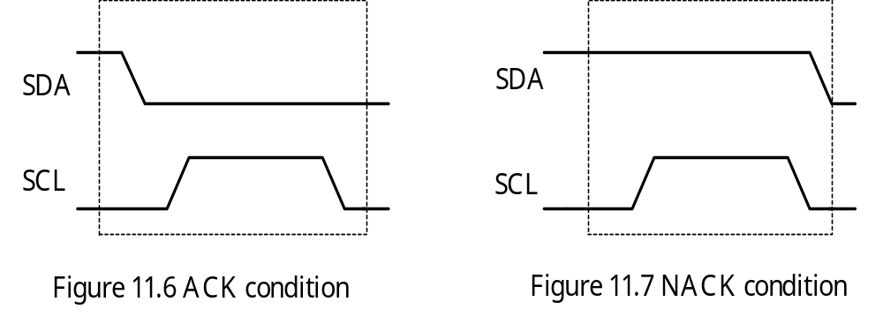
Acknowledge (ACK) Condition
Data transfer needs to be acknowledged either positively (ACK) or negatively (NACK).
A device acknowledges receiving a byte by bringing the SDA line low during the 9th clock pulse of SCL.
A device sends a negative acknowledgement by letting the SDA signal to float high during the 9th clock pulse of SCL.

Slide 8
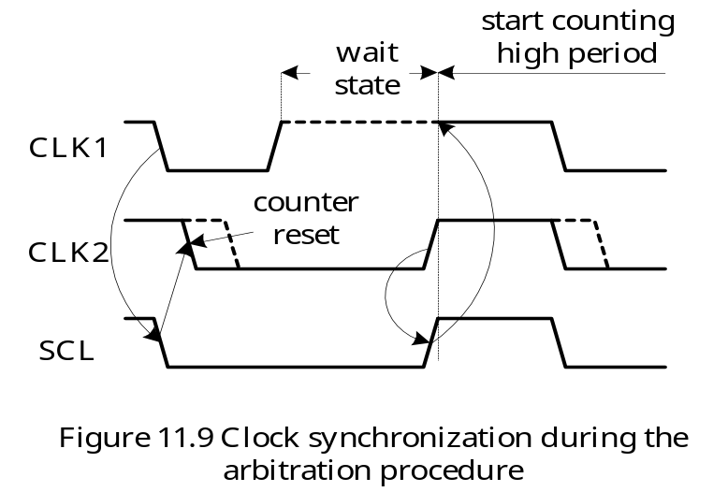
Arbitration
I²C allows multiple master devices to coexist
Multiple masters may attempt to transmit data at the same time
The master devices continue to transmit until one attempts a high while the other transmits a low.
The master devices attempting to transmit a high will detect a low on the SDA bus line and give up the bus.
The winning master continues its transmission without interruption

Slide 9
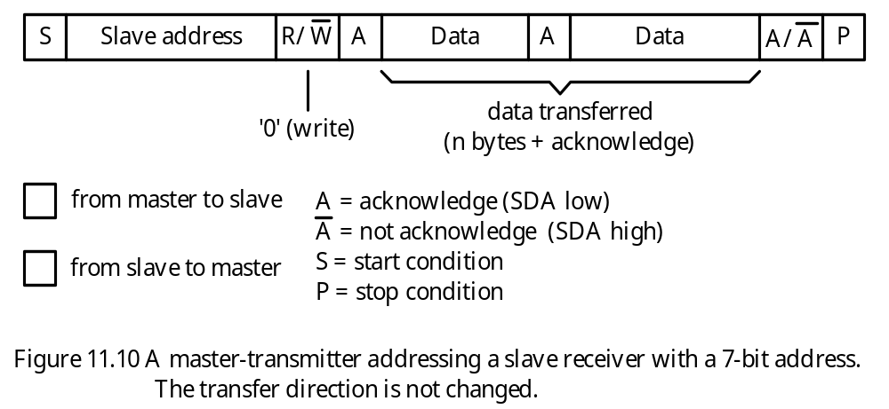
Data Transfer Format
- All data transfers are preceded by an address.
A master device can use either the 7-bit or the 10-bit address to specify a slave device.
Possible I²C data transfer formats include:
1. Master-transmitted to slave-receiver (see Figure 11.10).
2. Master reads slave immediately after the first byte (address byte) (see Figure 11.11).
3. Combined format (see Figure 11.12).

Slide 10
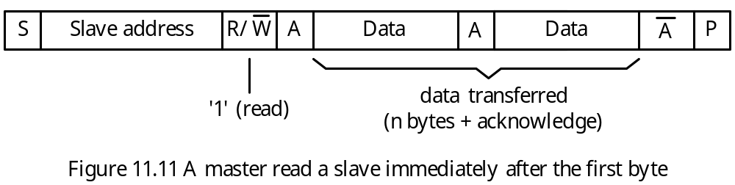
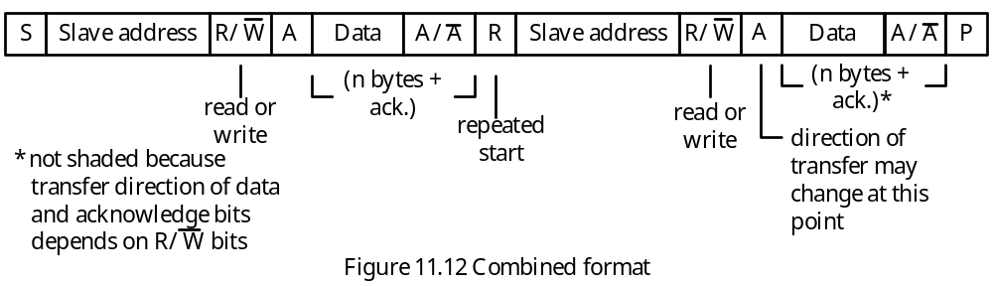

Slide 11
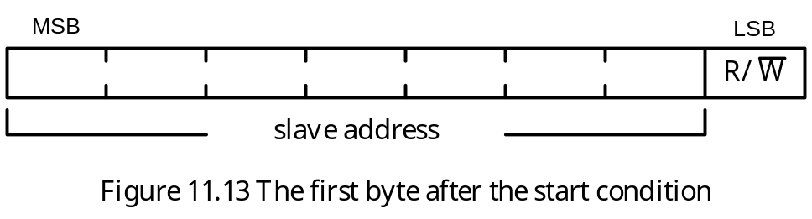
7-bit Addressing
The first byte after the start condition carries the 7-bit address and the direction of the message.
The format is shown in Figure 11.13.
- When an address is sent, each slave devices compares the first 7 bits with its address. If they match, the slave considers itself being addressed.
- The I²C bus committee coordinates the allocation of I²C addresses.
Two groups of 8 addresses (0000xxx and 1111xxx) are reserved for the purpose shown in Table 11.1.
The bit pattern 11110xx is reserved for 10-bit addressing.

Slide 12
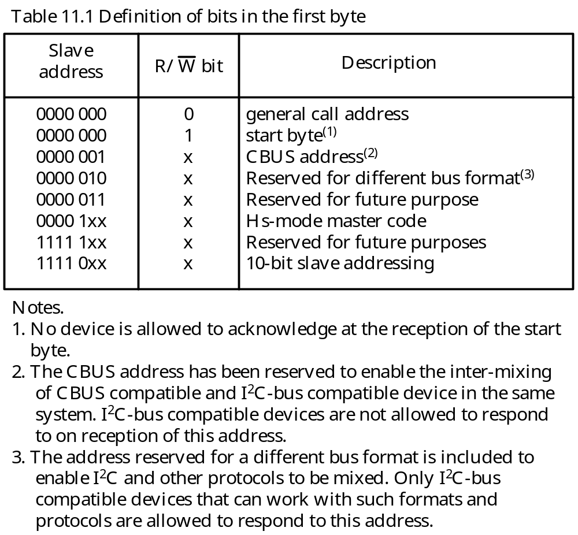

Slide 13
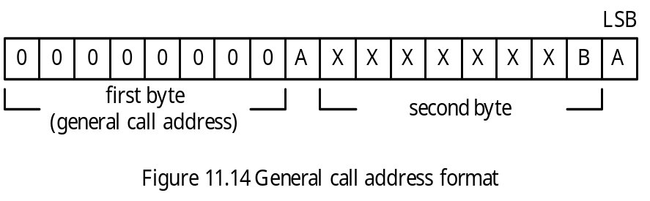
General Call Address
The general call address is for addressing every device connected to the I²C bus.
If a slave does not need any data supplied within the general call structure, it can ignore this address by not acknowledging it.
If a slave requires data from a general call address, it will acknowledge this address and behave as a slave receiver.
The second and following bytes will be acknowledged by every slave receiver capable of handling this data.
The meaning of the general call address is specified in the second byte as shown in Figure 11.14. This address won’t be discussed in detail.

Slide 14
10-bit Addressing
Ten-bit addressing can coexist with 7-bit addressing.
Does not affect 7-bit addressing
The 10-bit address is formed from the first two bytes following a start (S) condition or repeated start (R) condition.
The first seven bits of the first byte are 11110xx, of which xx are the two most significant bits of the 10-bit address.
The second byte is the lower 8 bits of the 10-bit address.
The bit 0 (R/W) of the first byte determines the direction of the following message.
Transfer Formats with 10-bit Address
Master-transmitter transmits to slave-receiver with a 10-bit slave address
Master-receiver reads slave-transmitter with a 10-bit address
Combined format 1 (master sends data to a slave and then reads from the same slave)
Combined format 2 (master sends data to a slave and then sends data to another slave)
Combined format 3 (10-bit and 7-bit addressing combined in one system)
These formats are illustrated in Figure 11.17 through 11.20.

Slide 15
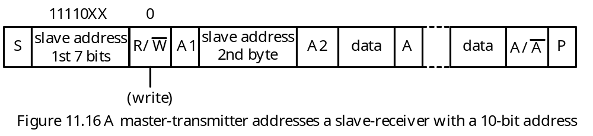
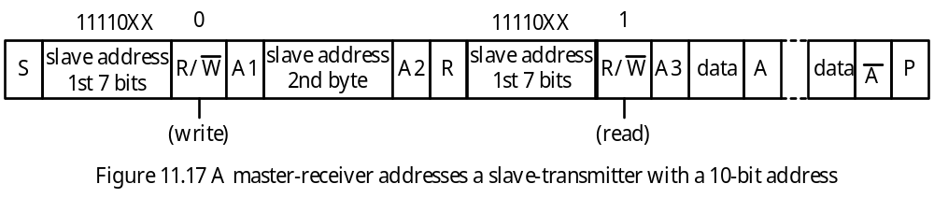
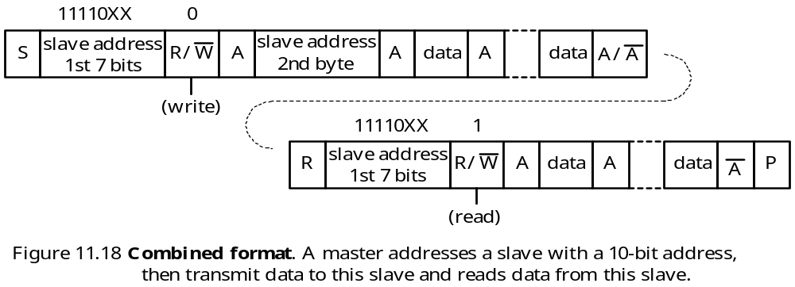

Slide 16
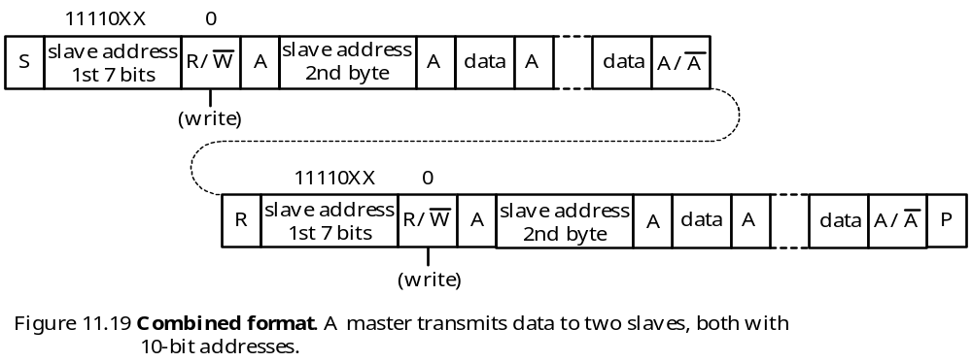
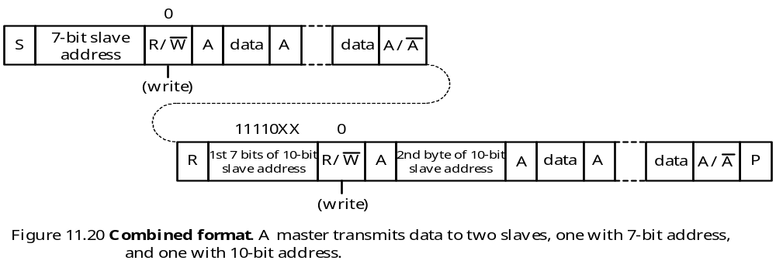

Slide 17
PIC18 MSSP Module in I²C Mode
Fully supports the I²C standard except the high-speed mode.
Supports both 7-bit and 10-bit addressing
Uses two pins: RC3/SCK/SCL and RC4/SDI/SDA
Both the SCL and the SDA pins must be configured for input in I²C operation
One needs to set the lowest 4 bits of the SSPCON1 register to one of the combinations shown in Figure 11.21 to configure MSSP in I²C mode.
Registers for I²C Operation
1. MSSP Control Register 1 (SSPCON1)
2. MSSP Control Register 2 (SSPCON2)
3. MSSP Status Register (SSPSTAT)
4. Serial Receive/Transmit Buffer (SSPBUF)
5. MSSP Shift Register (SSPSR)—not directly accessible
6. MSSP Address Register (SSPADD)
The SSPCON1 Register
Contents shown in Figure 11.21.

Slide 18
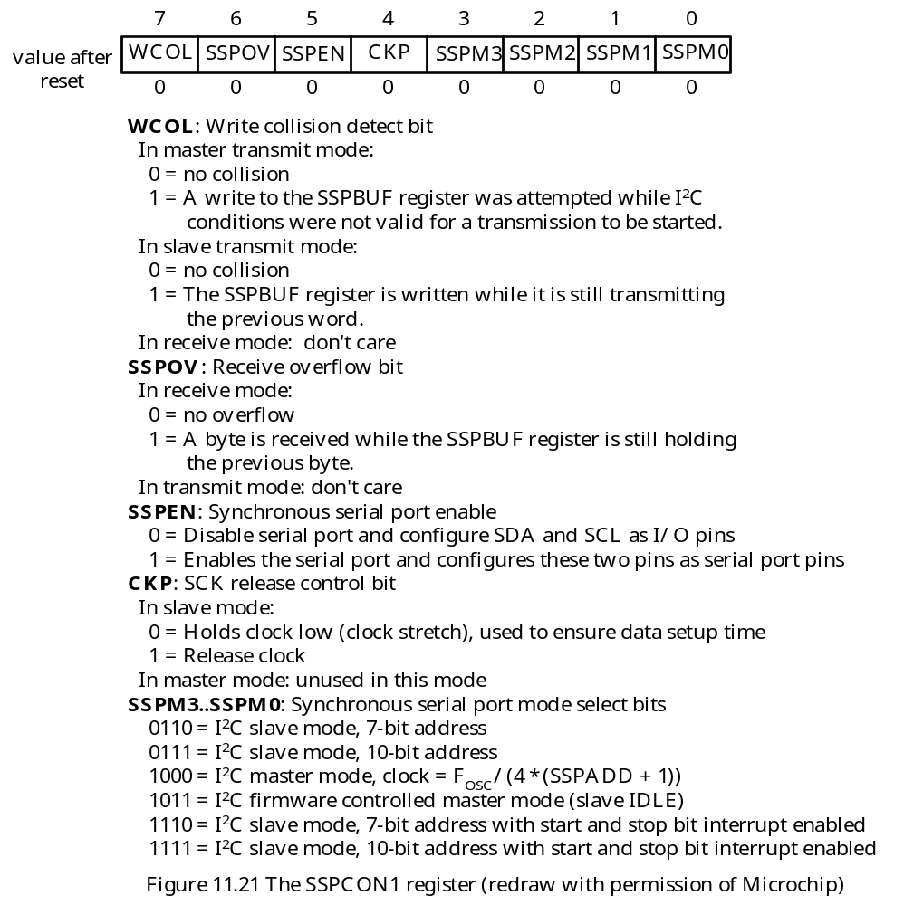

Slide 19
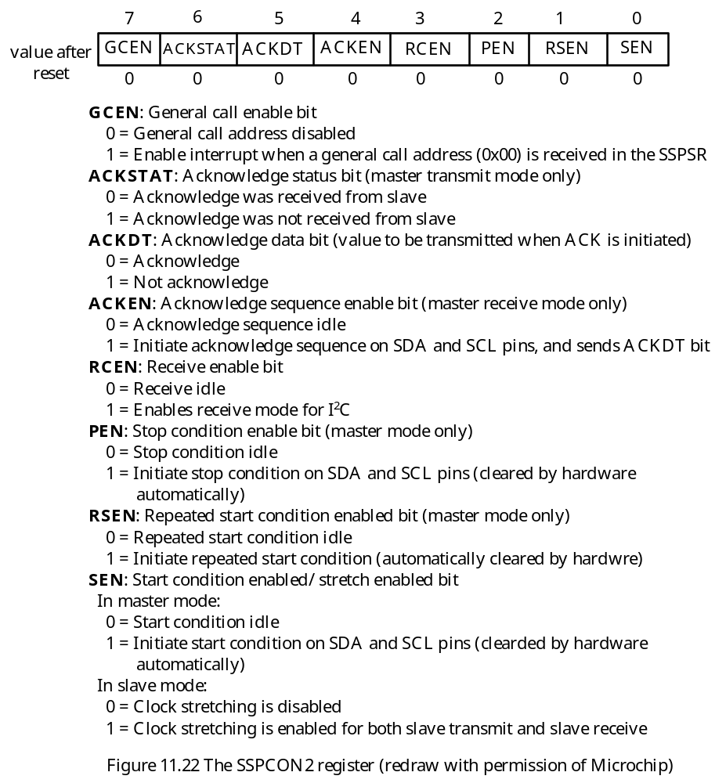
The SSPCON2 Register

Slide 20
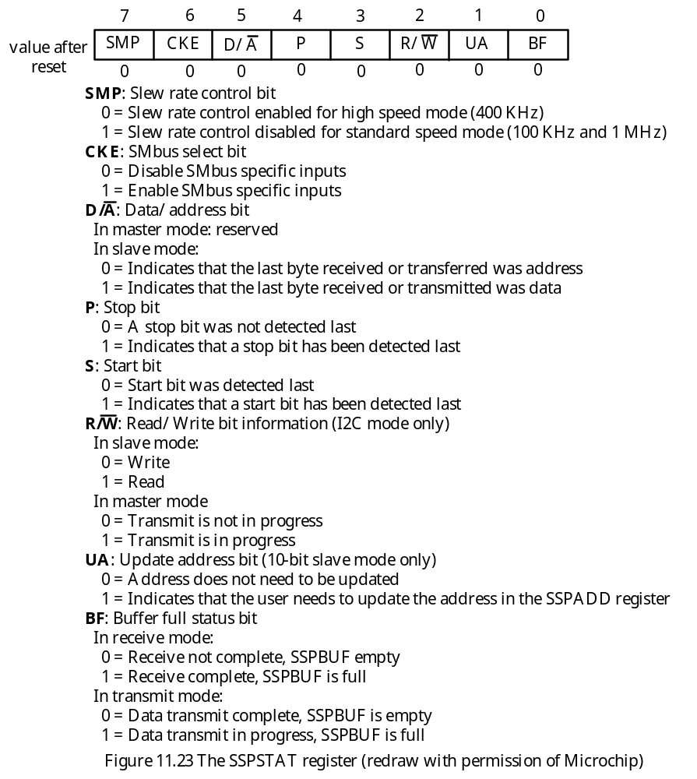
SSPSTAT Register

Slide 21
MSSP Address Register
In slave mode, this register holds the address information.
In 10-bit addressing, the slave must write the upper byte of the 10-bit address into this register before a data transfer is started and then write the lower byte of the address after the upper byte is matched.
In master mode, this register acts as the baud rate generator reload value.
PIC18 Master Mode Operation
Once the master mode is enabled, the user can perform the following operations:
1. Assert a START condition
2. Assert a REPEATED START condition
3. Write to the SSPBUF register to initiate transmission of data/address
4. Configure the I²C port to receive data
5. Assert an ACK condition at the end of a received data byte
6. Assert a STOP condition
These operations are performed very often and should be implemented as subroutines.

Slide 22
Assert a START condition
In assembly language,
start_i2c bsf SSPCON2,SEN ; activate a start condition
st_loop btfsc SSPCON2,SEN ; wait until start condition is complete
bra st_loop ; “
return 0
In C language,
void start_i2c (void)
{
SSPCON2bits.SEN;
while(!SSPCON2bits.SEN);
}

Slide 23
Assert a Repeated Start Condition
In assembly language,
restart bsf SSPCON2,RSEN ; activate a restart condition
rst_loop btfss SSPCON2,RSEN ; wait until restart condition is complete
bra rst_loop ; :
return 0
In C language,
void restart (void)
{
SSPCON2bits.RSEN = 1;
while(SSPCON2bits.RSEN);
}

Slide 24
Activate a STOP Condition
In assembly language,
stop_i2c bsf SSPCON2,PEN ; assert a stop condition
st_loop btfsc SSPCON2,PEN ; wait until stop condition is complete
bra st_loop
return 0
In C language,
void stop_i2c (void)
{
SSPCON2bits.PEN; /* assert a stop condition */
while(SSPCON2bits.PEN); /* wait until stop condition is complete */
}

Slide 25
Finding Out if I2C Port is Idle
The I²C port is idle if none of the following conditions is active:
1. Start condition
2. Stop condition
3. Repeated start
4. Acknowledge
5. Data reception
6. Data transmission
In Assembly language,
i2c_idle movlw 0x1F
andwf SSPCON2,W
bz chk_wr
bra i2c_idle ; wait until I²C bus is not busy
chk_wr btfsc SSPSTAT,R_W ; check to see if SSP is transmitting data
bra chk_wr
return 0
In C language,
void i2c_idle (void)
{
while ((SSPCON2 & 0x1F) | (SSPSTATbits.R_W);
}

Slide 26
Writing Data to I²C Bus
; This function writes data in WREG to I²C bus
writeI2C pushr WREG
call i2c_idle,0 ; make sure I²C bus is idle
popr WREG
movwf SSPBUF ; send out the byte
again_i2c btfsc SSPSTAT,BF ; wait until the byte is shifted out
bra again_i2c
return 0
In C language,
void writeI2C (unsigned char dat)
{
i2c_idle ();
SSPBUF = dat;
while(SSPSTATbits.BF); /* wait until data is shifted out */
}

Slide 27
Receiving a Byte from I2C
In assembly language,
read_i2c bsf SSPCON2,RCEN ; enable receive mode
rd_loop btfss SSPSTAT,BF ; wait until one byte has been shifted in
bra rd_loop
movf SSPBUF,W ; place data in WREG
return 0
In C language,
unsigned char ReadI2C (void)
{
SSPCON2bits.RCEN = 1;
while(!SSPSTATbits.BF); /* wait until a byte is received */
return (SSPBUF);
}

Slide 28
Acknowledging Reception of Data
In assembly language,
ackI2C bcf SSPCON2,ACKDT ; set acknowledge bit state for ACK
bsf SSPCON2,ACKEN ; initiate bus acknowledge sequence
ack_loop btfss SSPCON2,ACKEN ; wait until ACK sequence is complete
bra ack_loop ; “
return 0
In C language,
void AckI2C (void)
{
SSPCON2bits.ACKDT = 0;
SSPCON2bits.ACKEN = 0;
while (SSPCON2bits.ACKEN);
}

Slide 29
Not Acknowledging Reception of Data
In assembly language,
NotAckI2C bsf SSPCON2,ACKDAT ; set acknowledge bit state for NACK
bsf SSPCON2,ACKEN ; initiate an ACK sequence
NotAck_lp btfss SSPCON2,ACKEN ; wait until the NOT ACK sequence is complete
bra NotAck_lp
return 0
In C language,
void NotAckI2C (void)
{
SSPCON2bits.ACKDT = 1;
SSPCON2bits.ACKEN = 1;
while (SSPCON2bits.ACKEN);
}

Slide 30
Master Mode Transmit Sequence
The user generates a START condition by setting the START enable bit SEN.
The SSPIF flag bit is set. The MSSP module will wait for the required start time before any other operation takes place.
The user loads the SSPBUF with the slave address to transmit.
The MSSP module shifts out the address from the SDA pin.
The MSSP module shifts in the ACK bit from the slave device and writes its value into the SSPCON2 register (bit 6).
The MSSP module generates an interrupt at the end of the 9th clock cycle by setting the SSPIF flag.
The user loads the SSPBUF with eight bits of data.
The MSSP module shifts out data from the SDA pin.
The MSSP module shifts in the ACK bit from the slave device and writes its value into the SSPCON2 register (bit 6).
The MSSP module generates an interrupt at the end of the 9th clock cycle by setting the SSPIF flag.
The user generates a stop condition by setting the STOP enable bit PEN (bit 2).
The MSSP module generates an interrupt once the stop condition is complete.

Slide 31
Baud Rate Generator
In master mode, the baud rate generator (BRG) reload value is placed in the lower 7 bits of the SSPADD register.
When a write occurs to SSPBUF, the baud rate generator will begin counting.
The BRG counts down to 0 and stop until another reload has taken place.
The BRG count is decremented twice per instruction cycle.
Baud rate is calculated as follows:
baud rate = FOSC ÷ [4 × (BRG + 1)]
The baud rate reload value is calculated as follows:
BRG = FOSC ÷ (4 × baud_rate) – 1

Slide 32
PIC18 I²C Slave Mode
This mode allows the PIC18 to operate in a multimaster I²C environment.
The SCL and SDA must be configured for input.
The MSSP module will override the input state with the output data when required (slave transmitter).
When an address is matched or a data byte is received, the hardware automatically generate the ACK pulse.
If one of the following two conditions is true, the MSSP does not acknowledge:
1. The buffer full bit BF was set before the transfer was received.
2. The overflow bit SSPOV was set before the transfer was received

Slide 33
Slave Addressing
The user must write the slave address into the SSPADD register before reception is started.
Eight bits are shifted into the SSPSR register following the start condition.
The value of the register SSPSR<7:1> is compared with the SSPADD register on the falling edge of the 8th SCL pulse.
When these two registers match and the BF and SSPOV flags are not set, the following events will occur:
1. The SSPSR register value is loaded into the SSPBUF register.
2. The buffer full bit BF is set
3. An ACK pulse is generated.
4. The interrupt flag SSPIF is set on the falling edge of the 9th SCL pulse.
In 10-bit addressing, when the high byte is matched, the UA bit is set to 1.
The user must load the lower address byte into the SSPADD register.
If the lower byte is also matched, the MSSP will acknowledge again and wait for the following data byte or transmit data byte to the master device.

Slide 34
Reception in Slave Mode
In slave mode, the MSSP module is waiting for data to come when the R/W bit in the address byte is 0.
An MSSP interrupt is generated for each data byte received. The SSPIF flag must be cleared in software.
If the slave needs extra time to process the received byte, it can set the SEN bit to stretch the SCL clock.
The clock is released by setting the CKP bit (SSPCON1<4>).
Transmission in Slave Mode
If the R/W bit of the matched address byte is 1, the R/W bit of the SSPSTAT register is set.
If more time is needed to prepare data for transmission, user can clear the CKP bit of the SSPSTAT register to stretch the SCL clock (stay low).
After writing data into the SSPBUF register, the slave MSSP should set the CKP bit to release the SCL clock to allow the master to pulse the SCL line.

Slide 35
Example 11.1 Write a function to initialize the MSSP module to operate in the I²C mode with the following parameters assuming that f_{OSC} = 32 MHz:
I²C master mode
Enable slew rate control for high speed mode
Set baud rate to 400 KHz
Configure the SDA and SCL pins as serial port pins
Solution:
OpenI2C movlw 0x3F
andwf SSPSTAT,F ; clear the upper two bits of SSPSTAT
movlw 0x13 ; set baud rate to 400 KHz
movwf SSPADD ; “
clrf SSPCON1
clrf SSPCON2
bcf SSPSTAT,SMP ; enable slew rate control for high speed mode
bsf SSPSTAT,CKE ; enable SMBus inputs
bsf TRISC,SCL ; configure SCL pin for input
bsf TRISC,SDA ; configure SDA pin for input
movlw 0x28
iorwf SSPCON1,F ; select master mode, enable SDA and SCL pins
return 0

Slide 36
In C language,
void OpenI2C (void)
{
SSPSTAT &= 0x3F; /* enable slew rate control in high speed */
SSPADD = 0x13; /* set baud rate to 400 KHz */
SSPCON1 = 0x00; /* clear to reset state */
SSPCON2 = 0x00; /* clear to reset state */
SSPCON1 |= 0x28; /* enable serial port and select I²C master mode */
TRISCbits.RC3 = 1; /* configure SCL for input */
TRISCbits.RC4 = 1; /* configure SDA for input */
}

Slide 37
Microchip C18 Library Functions for I²C
The user must include the i2c.h file in order to use these functions.
void AckI2C (void); /* initiates ACK sequence */
void NotAckI2C (void); /* initiates a not acknowledge sequence */
void CloseI2C (void); /* disables MSSP module */
void IdleI2C (void); /* loops until I²C bus is idle */
unsigned char DataRdyI2C (void); /* determines if there is a byte in SSP buffer */
unsigned char getcI2C (void); /* read a single byte from I²C bus */
unsigned char ReadI2C (void);
unsigned char getsI2C (unsigned char *rdptr, unsigned char length);
- reads length bytes from I²C bus
- stores the string in a buffer pointed to by rdptr
unsigned char putcI2C (unsigned char data_out); /* output a byte to I²C bus */
unsigned char WriteI2C (unsigned char data_out);
unsigned char putsI2C (unsigned char *wrptr);
- writes a string pointed to by wrptr to the I²C bus.
- returns value based on the write condition:
0: if NULL character was reached
-2: if the slave I2C device responded with a NACK
-3: if a write collision occurred

Slide 38
void OpenI2C (unsigned char sync_mode, unsigned char slew);
sync_mode may have three values:
SLAVE_7 I²C slave mode, 7-bit address
SLAVE_10 I²C slave mode, 10-bit address
MASTER I²C master mode
slew may have two values:
SLEW_OFF Slew rate disabled for 100 KHz mode
SLEW_ON Slew rate enabled for 400 KHz mode
void RestartI2C (void); /* initiates a restart sequence */
void StartI2C (void); /* initiates a start sequence */
void StopI2C (void); /* initiates a stop sequence */
Note. Users need to use a while loop to wait until the I²C signal condition is complete when calling the following functions:
StartI2C( ), RestartI2C( ), StopI2C( ), AckI2C( ), and NotAckI2C( )

Slide 39
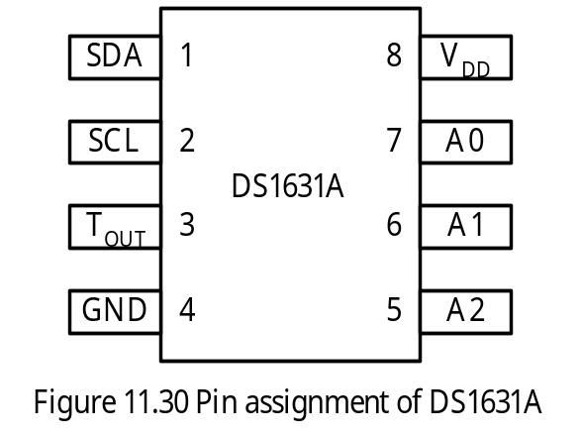
The Digital Thermometer and Thermostat DS1631A with I²C Interface
DS1631A can measure the current temperature.
DS1631A can warn the potential overheat of the system
DS1631A will assert a signal (T_{OUT}) whenever the temperature is higher than the pre-established trip point.
A2~A0 are the address inputs.
DS1361 converts the ambient temperature into 9-, 10-, 11-, or 12-bit readings over a range of -55ºC to +125ºC.
Functional diagram is shown in Figure 11.31.

Slide 40
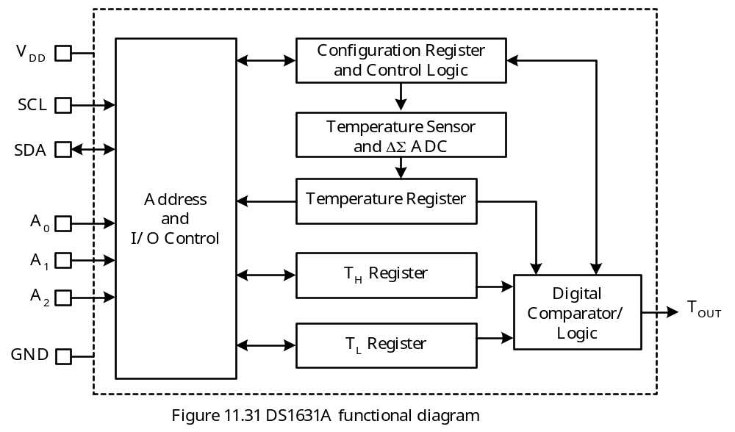

Slide 41
DS1631A Registers
Four registers support the operations of the DS1631A: Config, TH, TL, and Temperature.
Both TH and TL are EEPROM-based 2-byte registers.
TH holds the upper alarm temperature. When the Temperature register reading is equal to or higher than that in TH, the T_{OUT} signal is asserted.
Once asserted, the T_{OUT} signal won’t be deasserted until the Temperature reading is lower than that in TL.
The contents of the Config register are shown in Figure 11.32.

Slide 42
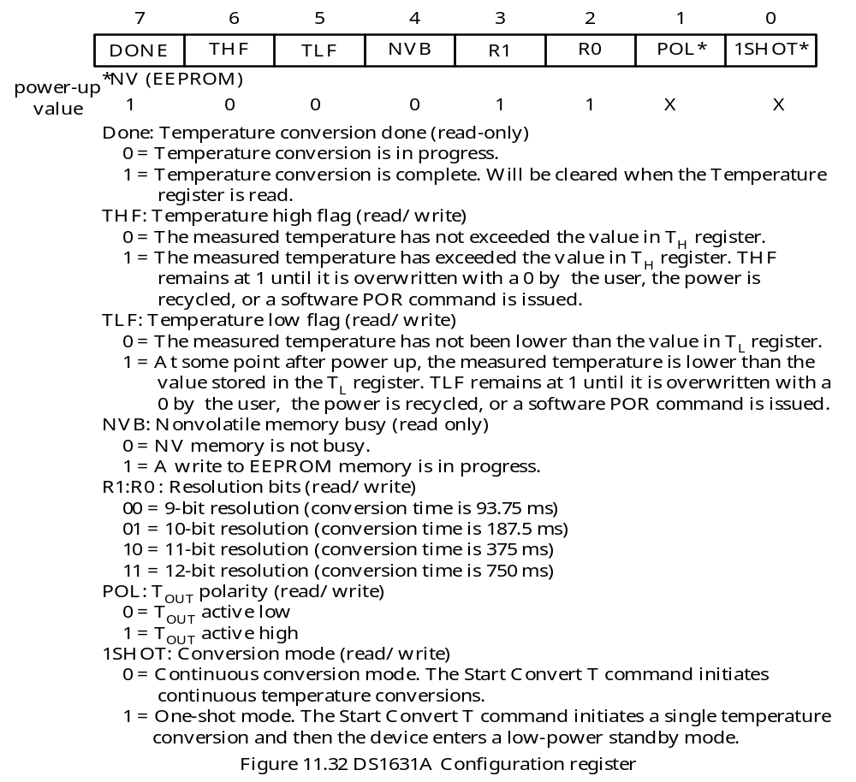

Slide 43
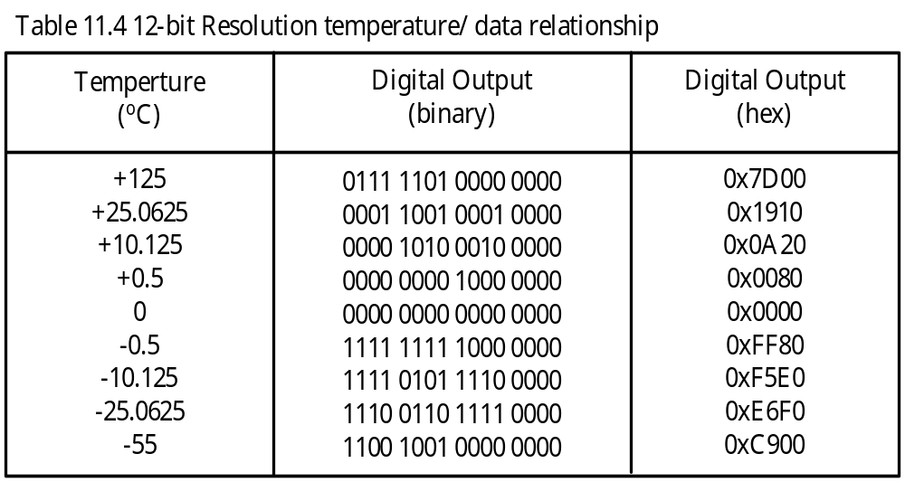
The DS1631 Operation
The default resolution of the DS1631A is 12-bit.
Bit 15 through bit 4 represent the temperature at 12-bit resolution.
Bit 15 through bit 5 represent the temperature at 11-bit resolution.
Bit 15 through bit 6 represent the temperature at 10-bit resolution.
Bit 15 through bit 7 represent the temperature at 9-bit resolution.
A sample of temperature/data relationship at 12-bit resolution is shown in Table 11.4.
Temperature is represented in 2’s complement format. The most significant bit is sign bit. Bit 15 to bit 8 represent the integer part of the temperature.

Slide 44
Interpreting the Temperature Reading
Using 12-bit resolution as example,
Positive Conversion Result
Step 1
Truncate the lowest 4 bits (unused bits).
Step 2
Divide the upper 12 bits by 16 (other resolutions divide by 8, 4, or 2).
Negative Conversion Result
Step 1
Compute the two’s complement of the conversion result.
Step 2
Truncate the lowest 4 bits.
Step 3
Divide the upper 12 bits of the two’s complement of the conversion result by 16.

Slide 45
DS1631A Command Set
Start Convert T [0x51]
Initiates temperature conversions. In one-shot mode, only one conversion is performed. In continuous mode, continuous temperature conversions are performed.
Stop Convert T [0x22]
Stops temperature conversions when the device is in continuous conversion mode.
Read Temperature [0xAA]
Reads last converted temperature value from the 2-byte temperature register.
Access TH [0xA1]
Reads or writes the 2-byte TH register.
Access TL [0xA2]
Reads or writes the 2-byte TL register.
Access Config [0xAC]
Reads or writes the 1-byte configuration register.
Software POR [0x54]
Initiates a software power-on-reset operation, which stops temperature conversions and resets all registers and logic to their power-up states. The software POR allows the user to simulate cycling the power without actually powering down the device.

Slide 46
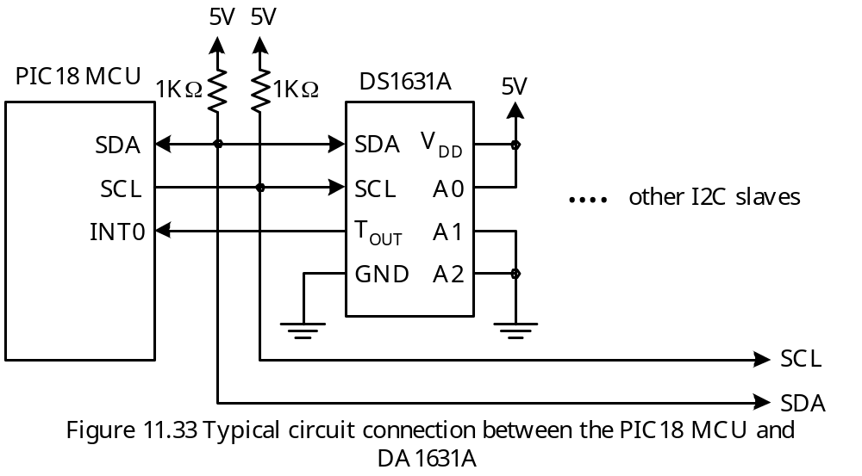
Circuit Connection for the DS1631A

Slide 47
Address of the DS1631A
- Depending on the connection of the A2~A0 pins, the 7-bit address of the DS1631A ranges from 0x48 to 0x4F.
- The 7-bit address and the R/W bit are referred to as the control byte.
Write Data to DS1631A
The PIC18 can write data to the DS1631A by issuing an Access Config, Access TH, Access TL command following the control byte.
Reading Data from DS1631A
The PIC18 can read data from DS1631A by issuing an Access Config, Access TH, Access TL, or Read Temperature command after the control byte.
After sending the control byte and receiving an ACK from DS1631A, the I²C master must initiate a RESTART condition and send a control byte with R/W bit set to 1.

Slide 48
Example 11.2 Write an instruction sequence to configure the DS1631A in Figure 11.33 to operate in continuous conversion mode and set the T_{OUT} polarity to active high. Assume that the I²C bus has only one master and there is no possibility in getting bus collision.
Solution:
Procedure for configuring the DS1631A:
Step 1
Assert a START condition.
Step 2
Sends a control byte (0x92) to the DS1631A with R/W = 0.
Step 3
Wait until I²C bus is idle and check to see if the DS1631A acknowledges. If not, exit.
Step 4
Sends an Access Config command to the DS1631A.
Step 5
Wait until I²C bus is idle and check to see if the DS1631A acknowledges. If not, exit.
Step 6
Write an appropriate command byte to configure the DS1631A.
Step 7
Wait until I²C bus is idle and check to see if the DS1631A acknowledges. If not, exit.
Step 8
Assert a STOP condition to complete the whole process.

Slide 49
open_DS1631A
call i2c_idle ; ensure I²C module is idle
bsf SSPCON2,SEN ; generate a START condition
loop1 btfsc SSPCON2,SEN ; wait until start condition is completed
bra loop1 ; "
movlw 0x92 ; send out control byte to DS1631A
movwf SSPBUF,A ; "
loop2 btfsc SSPSTAT,BF ; wait until 8 bits have been shifted out
bra loop2 ; "
call i2c_idle ; ensure I²C module is idle
btfsc SSPCON2,ACKSTAT ; check ACK bit
goto bad1 ; receive NACK
movlw 0xAC ; sends Access Config command
movwf SSPBUF ; "
loop3 btfsc SSPSTAT,BF ; wait until 8 bits have been shifted out
bra loop3 ; "
call i2c_idle
btfsc SSPCON2,ACKSTAT ; check ACK bit
goto bad1
movlw 0x02 ; select continuous conversion mode and set
movwf SSPBUF ; T_{OUT} polarity to active high

Slide 50
loop4 btfsc SSPSTAT,BF
bra loop4
call i2c_idle
btfsc SSPCON2,ACKSTAT
goto bad1
bsf SSPCON2,PEN ; generate a stop condition
loop5 btfsc SSPCON2,PEN ; wait until stop condition is complete
bra loop5
movlw 0x00 ; set return code 0
return 0 ; “
bad1 movlw 0xFF ; set return code to -1
return 0 ; “
The C language version of the function is in the next slide.

Slide 51
char open_ds1631A (void)
{
IdleI2C( );
StartI2C(); /* generate a START condition */
while(SSPCON2bits.SEN); /* wait until START condition is complete */
if (WriteI2C(0x92)) /* send control code with R/W = 0 */
return -1;
IdleI2C( );
if (SSPCON2bits.ACKSTAT) /* received ACK ? */
return -1;
if (WriteI2C(0xAC)) /* send Access Config command */
return -1;
IdleI2C();
if (SSPCON2bits.ACKSTAT)
return -1;
if(WriteI2C(0x02)) /* configure DS1631A in continuous conversion */
return -1; /* mode and select T_{OUT} assertive high */
IdleI2C();
if (SSPCON2bits.ACKSTAT)
return -1;
StopI2C(); /* generate a STOP condition */
}

Slide 52
Example 11.3 Write a function to start temperature conversion.
The Procedure
Step 1
Assert a START condition. Make sure that the I²C module is idle before doing this.
Step 2
Sends a control byte (0x92) to the DS1631A with R/W = 0.
Step 3
Wait until I²C bus is idle and check to see if the DS1631A acknowledges. If not, exit.
Step 4
Sends a “Start Convert T” command to the DS1631A.
Step 5
Wait until I²C bus is idle and check to see if the DS1631A acknowledges. If not, exit.
Step 6
Assert a STOP condition to complete the whole process.

Slide 53
start_conv call i2c_idle ; ensure that I²C module is idle
bsf SSPCON2,SEN ; generate a START condition
loop1 btfsc SSPCON2,SEN ; wait until start condition is completed
bra loop1 ; "
movlw 0x92 ; send out control byte to DS1631A
movwf SSPBUF ; "
loop2 btfsc SSPSTAT,BF ; wait until 8 bits have been shifted out
bra loop2 ; "
call i2c_idle ; ensure I²C bus is idle
btfsc SSPCON2,ACKSTAT ; check ACK bit
goto bad1 ; receive NACK
movlw 0x51 ; sends Start Convert T command
movwf SSPBUF ; "
loop3 btfsc SSPSTAT,BF ; wait until 8 bits have been shifted out
bra loop3 ; "
call i2c_idle
btfsc SSPCON2,ACKSTAT ; check ACK bit
goto bad1
bsf SSPCON2,PEN ; generate a stop condition
loop5 btfsc SSPCON2,PEN ; wait until stop condition is complete
bra loop5

Slide 54
movlw 0x00 ; return 0 to indicate successful command
return 0
bad1 movlw 0xFF ; set return code to -1
return 0 ; "
char start_conv_T (void)
{
IdleI2C( ); /* ensure the I²C module is idle */
StartI2C(); /* generate a START condition */
while(SSPCON2bits.SEN); /* wait until START condition is complete */
if (WriteI2C(0x92)) /* send control code with R/W = 0 */
return -1;
IdleI2C( );
if (SSPCON2bits.ACKSTAT) /* received ACK ? */
return -1;
if(WriteI2C(0x51)) /* send Start Convert T command */
return -1;
IdleI2C();
if (SSPCON2bits.ACKSTAT)
return -1;
StopI2C( ); /* generate a STOP condition */
return 0;
}

Slide 55
Procedure for set the high thermostat temperature
Step 1
Assert the START condition.
Step 2
Send control byte 0x92 with R/W bit = 0;
Step 3
Wait until I²C bus is idle and check to see if the DS1631A acknowledges. If not, exit.
Step 4
Send Access TH command to DS1631A.
Step 5
Wait until I²C bus is idle and check to see if the DS1631A acknowledges. If not, exit.
Step 6
Send the upper byte of the thermostat temperature to the DS1631A.
Step 7
Wait until I²C bus is idle and check to see if the DS1631A acknowledges. If not, exit.
Step 8
Send the lower byte of the thermostat temperature to the DS1631A.
Step 9
Wait until I²C bus is idle and check to see if the DS1631A acknowledges. If not, exit.
Step 10
Assert the STOP condition.

Slide 56
; Program to set TH
set_TH call i2c_idle
bsf SSPCON2,SEN ; generate a START condition
loop1 btfsc SSPCON2,SEN ; wait until start condition is completed
bra loop1 ; "
movlw 0x92 ; send out control byte to DS1631A
movwf SSPBUF ; "
loop2 btfsc SSPSTAT,BF ; wait until 8 bits have been shifted out
bra loop2 ; "
call i2c_idle ; ensure I²C bus is idle
btfsc SSPCON2,ACKSTAT ; check ACK bit
goto bad1 ; receive NACK
movlw 0xA1 ; sends "Access TH" command
movwf SSPBUF ; "
loop3 btfsc SSPSTAT,BF ; wait until 8 bits have been shifted out
bra loop3 ; "
call i2c_idle
btfsc SSPCON2,ACKSTAT ; check ACK bit
goto bad1
movff PRODH,SSPBUF ; sends upper byte of TH
loop4 btfsc SSPSTAT,BF
bra loop4

Slide 57
call i2c_idle
btfsc SSPCON2,ACKSTAT ; check ACK bit
goto bad1
movff PRODL,SSPBUF ; send lower byte of TH
loop5 btfsc SSPSTAT,BF
bra loop4
call i2c_idle
btfsc SSPCON2,ACKSTAT ; check ACK bit
goto bad1
bsf SSPCON2,PEN ; generate a stop condition
loop6 btfsc SSPCON2,PEN ; wait until stop condition is complete
bra loop5
movlw 0x00
return
bad1 movlw 0xFF ; set return code to -1
return ; "

Slide 58
Procedure to Read the Config Register
Step 1
Assert the START condition.
Step 2
Send control byte 0x92 with R/W bit = 0.
Step 3
Wait until I²C bus is idle and check to see if the DS1631A acknowledges. If not, exit.
Step 4
Send an Access Config command (0xAC) to the DS1631A.
Step 5
Wait until I²C bus is idle and check to see if the DS1631A acknowledges. If not, exit.
Step 6
Assert a Repeat START condition.
Step 7
Send the control byte 0x93 with R/W bit = 1.
Step 8
Wait until I²C bus is idle and check to see if the DS1631A acknowledges. If not, exit.
Step 9
Read in the Config register.
Step 10
Make sure that the I²C bus is idle and send back an NACK to the DS1631A.
Step 11
Assert the STOP condition.

Slide 59
; ***********************************************************************
; The following function reads the Config register and returns the result in PRODL.
; ***********************************************************************
read_conf bsf SSPCON2,SEN ; assert a START condition
lop1 btfsc SSPCON2,SEN ; wait until start condition is completed
bra lop1 ; "
movlw 0x92 ; send control byte to DS1631A, R/W = 0
movwf SSPBUF ; "
lop2 btfsc SSPSTAT,BF ; wait until 8 bits have been shifted out
bra lop2 ; "
call i2c_idle ; ensure I²C bus is idle
btfsc SSPCON2,ACKSTAT ; check ACK bit
goto bad2 ; receive NACK
movlw 0xAC ; sends Access Config command
movwf SSPBUF ; "
lop3 btfsc SSPSTAT,BF ; wait until 8 bits have been shifted out
bra lop3 ; "
call i2c_idle
btfsc SSPCON2,ACKSTAT ; check ACK bit
goto bad2
bsf SSPCON2,RSEN ; assert a Repeat START condition

Slide 60
lop4 btfsc SSPCON2,RSEN ; wait until Repeat START condition is complete
bra lop4 ; "
movlw 0x93 ; send control byte to the DS1631A with
movwf SSPBUF ; R/W = 1
lop5 btfsc SSPSTAT,BF ; wait until 8 bits are shifted out
bra lop5
call i2c_idle ; make sure I²C is idle
btfsc SSPCON2,ACKSTAT ; check ACK bit
goto bad2
bsf SSPCON2,RCEN ; enable reception
lop6 btfss SSPSTAT,BF ; wait until 8 bits have been shifted in
bra lop6 ; "
movff SSPBUF,PRODL ; transfer Config register contents to PRODL
call i2c_idle ; make sure I2C is idle
bsf SSPCON2,ACKDT ; send NACK
bsf SSPCON2,ACKEN ; "
lop7 btfsc SSPCON2,ACKEN ; wait until NACK is complete
bra lop7
bsf SSPCON2,PEN ; assert STOP condition

Slide 61
lop8 btfsc SSPCON2,PEN
bra lop8
movlw 0x00 ; set return code to 0
return
bad2 movlw 0xFF ; set return code to -1
return
The function in C language
unsigned char read_conf (void)
{
unsigned char return_val;
StartI2C( );
while(SSPCON2bits.SEN); /* wait until START condition is complete */
if (WriteI2C(0x92)) /* send control code with R/W = 0 */
return -1;
IdleI2C( );

Slide 62
if (SSPCON2bits.ACKSTAT) /* received ACK ? */
return -1;
if(WriteI2C(0xAC)) /* send Access Config command */
return -1;
IdleI2C();
if (SSPCON2bits.ACKSTAT)
return -1;
RestartI2C( ); /* assert a repeated start condition */
while(SSPCON2bits.RSEN); /* wait until restart is complete */
if(WriteI2C(0x93)) /* send control byte with R/W = 1 */
return -1;
IdleI2C( );
if (SSPCON2bits.ACKSTAT)
return -1;
return_val = ReadI2C( ); /* read Config Register */
IdleI2C();
NotAckI2C();
StopI2C();
return return_val;
}

Slide 63
Example 11.6 Write a subroutine to read the converted temperature and return the upper and lower bytes in PRODH and PRODL, respectively. Assume that the temperature conversion has been started but this function needs to make sure that the converted temperature value is resulted from the most recent “Start Convert T” command. Return error code in WREG.
Solution:
read_temp call read_conf
btfss PRODL,7 ; wait until a new conversion
bra read_temp ; result is available
call i2c_idle ; wait until I²C bus is idle
bsf SSPCON2,SEN ; assert a START condition
lp1 btfsc SSPCON2,SEN ; wait until start condition is completed
bra lp1 ; "
movlw 0x92 ; send control byte to DS1631A with R/W = 0
movwf SSPBUF ; "
lp2 btfsc SSPSTAT,BF ; wait until 8 bits have been shifted out
bra lp2 ; "
call i2c_idle ; ensure I²C bus is idle
btfsc SSPCON2,ACKSTAT ; check ACK bit
goto bad3 ; receive NACK

Slide 64
movlw 0xAA ; sends "Read Temperature" command
movwf SSPBUF ; "
lp3 btfsc SSPSTAT,BF ; wait until 8 bits have been shifted out
bra lp3 ; "
call i2c_idle
btfsc SSPCON2,ACKSTAT ; check ACK bit
goto bad3
bsf SSPCON2,RSEN ; assert a Repeated START condition
lp4 btfsc SSPCON2,RSEN ; wait until Repeated START is complete
bra lp4 ; "
movlw 0x93 ; send control byte to the DS1631A with
movwf SSPBUF ; R/W = 1
lp5 btfsc SSPSTAT,BF ; wait until 8 bits are shifted out
bra lp5 ; "
call i2c_idle ; make sure I2C is idle
btfsc SSPCON2,ACKSTAT ; check ACK bit
bra bad3
bsf SSPCON2,RCEN ; enable reception
lp6 btfss SSPSTAT,BF ; wait until 8 bits have been shifted in
bra lp6 ; "
movff SSPBUF,PRODH ; transfer converted temperature hi-byte to PRODH
call i2c_idle ; make sure I²C is idle

Slide 65
bcf SSPCON2,ACKDT ; sends ACK
bsf SSPCON2,ACKEN ; "
lp7 btfsc SSPCON2,ACKEN ; wait until ACK is done
bra lp7
bsf SSPCON2,RCEN ; enable another reception
lp8 btfss SSPSTAT,BF ; wait until 8 bits are received
bra lp8 ; "
movff SSPBUF,PRODL ; copy temperature low byte to PRODL
call i2c_idle
bsf SSPCON2,ACKDT ; send NACK
bsf SSPCON2,ACKEN ; "
lp9 btfsc SSPCON2,ACKEN ; wait until NACK is done
bra lp9
bsf SSPCON2,PEN ; assert STOP condition
lp10 btfsc SSPCON2,PEN
bra lp10
movlw 0x00 ; set return code to 0
return
bad3 movlw 0xFF
return

Slide 66
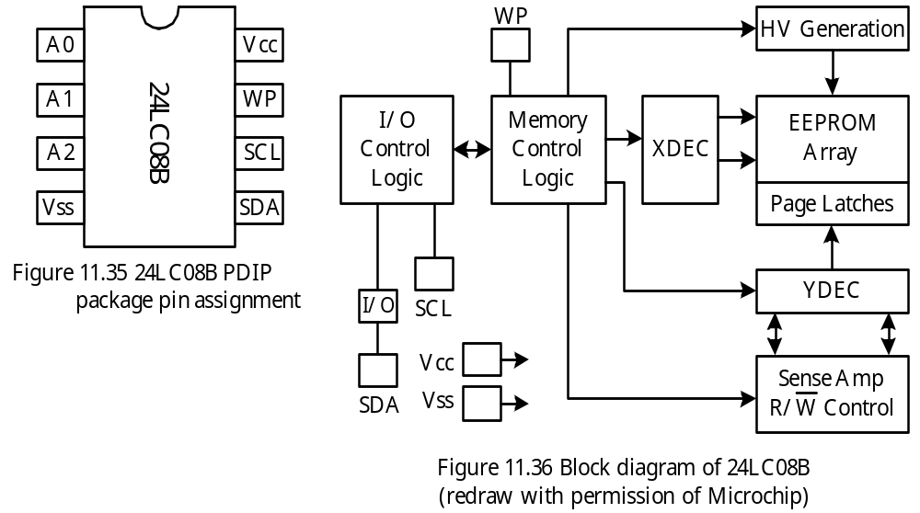
Serial EEPROM 24LC08B with I2C
Some embedded systems are powered by batteries and require large amount of non- volatile memory.
Serial EEPROMs with large capacity suit this type of application well.
The 24LC08B is a serial EEPROM with I²C interface from Microchip.

Slide 67
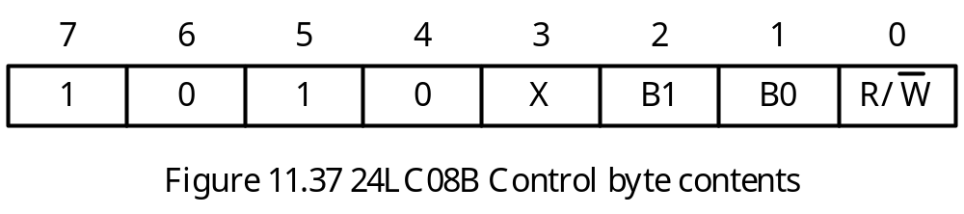
The 24LC08B has 1 KB capacity and is divided into 4 blocks of 256 bytes.
The 24LC08B has a page write capability for up to 16 bytes of data.
Control Byte for the 24LC08B
- The upper 4 bits of the control byte are the device address of the 24LC08B.
- Address inputs A2-A0 of the 24LC08B are not used and can be left floating.
- B1 and B0 bits in the control byte are block address.

Slide 68
Byte Write Operation
Master asserts the START condition.
The master sends the control byte to the 24LC08B.
The 24LC08B acknowledges the data transmission.
The master sends the byte address to the 24LC08B.
The 24LC08B acknowledges the data transmission.
The master sends the data byte to the 24LC08B.
The 24LC08B acknowledges the data transmission.
The master asserts the STOP condition.
Page Write Operation
In a page write operation, the user sends in the address of the first memory location to be written.
The 24LC08B has an internal write buffer to hold the incoming data.
When the STOP condition is received, the data in the buffer will be written into the EEPROM.
After each data byte is written into the write buffer, the internal address pointer is incremented by 1.

Slide 69
Acknowledge Polling
When the 24LC08B is writing the data in the write buffer into the EEPROM array, it does not acknowledge any further write operation.
The user can utilized this fact to find out if the internal write operation has been completed.
The acknowledge polling process is shown in Figure 11.38.

Slide 70
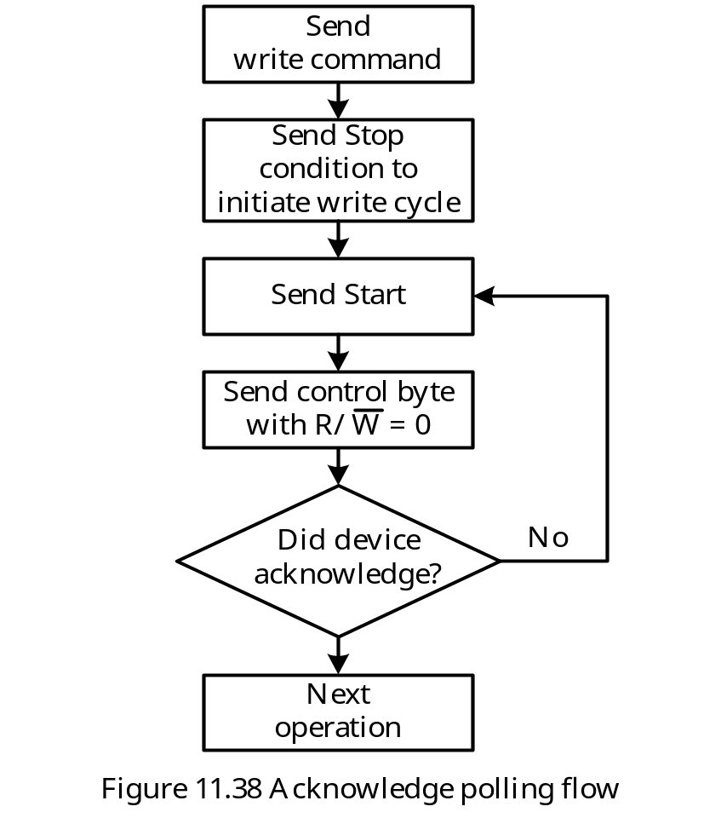

Slide 71
Read Operation
24LC08B supports three types of read operations:
1. Current address read
2. Random read
3. Sequential read

Slide 72
Random Read Procedure
Step 1
The master asserts a START condition.
Step 2
The master sends the control byte to the 24LC08B.
Step 3
The 24LC08B acknowledges the control byte.
Step 4
The master sends the address of the byte to be read to the 24LC08B.
Step 5
The 24LC08B acknowledges the byte address.
Step 6
The master asserts a repeated START condition.
Step 7
The master sends the control byte with R/W = 1.
Step 8
The 24LC08B acknowledges the control byte and sends the data to the master.
Step 9
The master asserts NACK to the 24LC08B.
Step 10
The master asserts the STOP condition.

Slide 73
Current Address Read
The internal EEPROM address pointer is incremented after each read or write access.
Using current address read allows the user to read the next sequential byte.
To perform current address read, the user performs the following operations:
1. Initiating a START condition.
2. Sending the control byte of the EEPROM with R/W bit set to 1.
3. Waiting for the ACK from the EEPROM.
4. Setting the RCEN bit of the SSPCON2 register to trigger 8 SCL pulses to shift in data.
4. Sending out NACK.
5. Initiating a STOP condition.
Sequential Address Read
Performed after a random read or sequential read has been started.
The user simply set the RCEN bit of the SSPCON2 register to trigger 8 SCL pulses to shift in a byte.

Slide 74
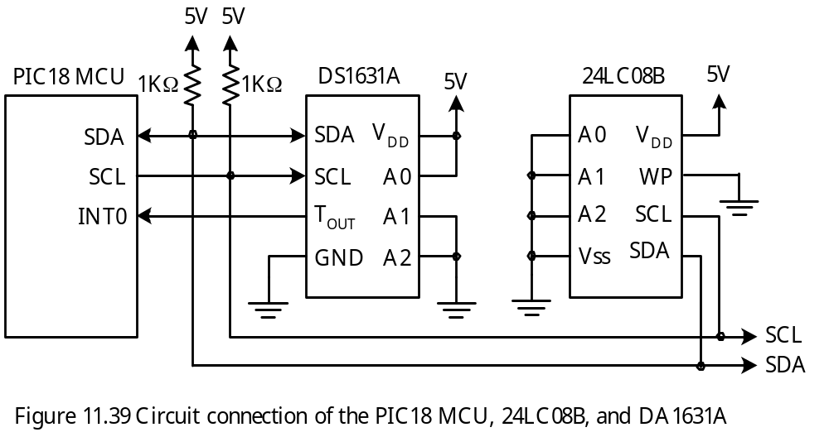
Circuit Connection

Slide 75
Example 11.7 Write a function to read a byte from the 24LC08B. Pass the control byte and address in PRODH and PRODL to this subroutine. Return the data byte and error code in PRODL and PRODH, respectively. This function should check two errors:
Bus collision (to make this function usable in a multi-master environment)
Not ACK (implies that 24LC08B may be in error)
Solution:
rand_read call i2c_idle ; make sure the I²C bus is idle
bsf SSPCON2,SEN ; assert START condition
eloop1 btfsc SSPCON2,SEN ; wait until START condition is done
bra eloop1 ; "
btfss PIR2,BCLIF ; test bus collision error
goto next1
movlw 0xFF ; set error code to -1
movwf PRODH ; "
return ; "
next1 call i2c_idle ; avoid write collision
movff PRODH,SSPBUF ; send out control byte
eloop2 btfsc SSPSTAT,BF ; wait until data is shifted out
bra eloop2 ; "
call i2c_idle ; wait until MSSP module is not busy
btfsc SSPCON2,ACKSTAT ;
goto not_ack ; NACK error

Slide 76
call i2c_idle ; make sure MSSP module is idle
movff PRODL,SSPBUF ; send address to 24LC08B
eloop3 btfsc SSPSTAT,BF ; wait until data is shifted out
bra eloop3
call i2c_idle
btfsc SSPCON2,ACKSTAT ; check NACK error
goto not_ack
call i2c_idle
bsf SSPCON2,RSEN ; assert repeated start condition
eloop4 btfsc SSPCON2,RSEN ; wait until repeated START condition
goto eloop4 ; is complete
btfss PIR2,BCLIF ; test bus collision error
goto next2
movlw 0xFF ; set error code to -1
movwf PRODH ; "
return ; "
next2 movlw 0x01
addwf PRODH,W ; set the R/W bit of control byte to 1
movwf SSPBUF ; send out the control byte to read
eloop5 btfsc SSPSTAT,BF ; wait until 8 bits have been shifted out
bra eloop5 ; "
call i2c_idle

Slide 77
btfsc SSPCON2,ACKSTAT ; check NACK error
goto not_ack
bsf SSPCON2,RCEN ; enable receive
eloop6 btfss SSPSTAT,BF ; wait until 8 bits have been shifted in
bra eloop6
bsf SSPCON2,ACKDT ; assert NACK condition
bsf SSPCON2,ACKEN ; "
eloop7 btfsc SSPCON2,ACKEN ; "
bra eloop7
bsf SSPCON2,PEN ; assert STOP condition
eloop8 btfsc SSPCON2,PEN ; wait until STOP condition is complete
bra eloop8 ; "
btfss PIR2,BCLIF ; test bus collision error
goto next3 ; "
movlw 0xFF
movwf PRODH ; "
return ; "
next3 movff SSPBUF,PRODL ; place data in PRODL
clrf PRODH ; set error code to 0 (no error)
return
not_ack movlw 0xFE ; return -2 as the error code
movwf PRODH ; "
return

Slide 78
In C language,
unsigned int EERandomRead ( unsigned char control, unsigned char address )
{
IdleI2C( ); // make sure I²C module is idle
StartI2C( ); // assert a START condition
while (SSPCON2bits.SEN); // wait until start condition is over
if (PIR2bits.BCLIF) // test for bus collision
return (-1); // return with Bus Collision error
IdleI2C( ); // make sure I²C module is idle
WriteI2C(control);
IdleI2C(); // make sure I²C module is idle
if (SSPCON2bits.ACKSTAT ) // test for NACK condition
return (-2);
IdleI2C( );
WriteI2C(address); //send out read address
IdleI2C( ); // ensure module is idle
if (SSPCON2bits.ACKSTAT ) // test for ACK condition, if received
return (-2); // return NACK error
RestartI2C( ); // assert I²C bus restart condition
while ( SSPCON2bits.RSEN ); // wait until re-start condition is over

Slide 79
if (PIR2bits.BCLIF) // test for bus collision
return (-1); // return with Bus Collision error
IdleI2C( );
WriteI2C(control+1); // write 1 byte - R/W bit should be 1
IdleI2C( ); // ensure module is idle
if (SSPCON2bits.ACKSTAT) // test for NACK condition
return (-2);
SSPCON2bits.RCEN = 1; // enable master for 1 byte reception
while (SSPCON2bits.RCEN); // check that receive sequence is over
NotAckI2C( ); // send NACK condition
while (SSPCON2bits.ACKEN); // wait until ACK sequence is over
StopI2C( ); // send STOP condition
while (SSPCON2bits.PEN ); // wait until stop condition is over
if (PIR2bits.BCLIF) // test for bus collision
return (-1); // return with Bus Collision error
return ((unsigned int) SSPBUF); // return with data
}

Slide 80
Example 11.8 Write a subroutine that writes a byte into the 24LC08B. The control byte, address, and data to be written are passed to this routine in the software stack.
Solution:
ctl_ byte equ -5 ; offset from top of software stack
addr equ -4 ; “
dat equ -3 ; “
; *********************************************************************
; The following subroutine writes a byte into the EEPROM. The control byte, address,
; and data byte are passed to this function in that order.
; *********************************************************************
wr_byte_ee pushr FSR2L ; save callers frame pointer
pushr FSR2H ; "
movff FSR1L,FSR2L ; set up new stack frame
movff FSR1H,FSR2H ; pointer
call i2c_idle
bsf SSPCON2,SEN ; assert the START condition
weloop1 btfsc SSPCON2,SEN ; wait until START condition is complete
goto weloop1
btfss PIR2,BCLIF ; check bus collision error
goto next1
dealloc_stk 3 ; deallocate three bytes in software stack
movlw 0xFF ; return bus collision error code (-1)

Slide 81
next1 call i2c_idle
movlw ctl_byte ; send out control byte to 24LC08B
movff PLUSW2,SSPBUF ; "
weloop2 btfsc SSPSTAT,BF ; wait until control byte is shifted out
bra weloop2 ; "
call i2c_idle
btfsc SSPCON2,ACKSTAT ; check NACK error
goto nack_err
movlw addr
movff PLUSW2,SSPBUF ; send out memory address to be accessed
weloop3 btfsc SSPSTAT,BF ; wait until address is shifted out
goto weloop3 ; "
call i2c_idle
btfsc SSPCON2,ACKSTAT ; check NACK error
goto nack_err
movlw dat ; send out the write data to 24LC08B
movff PLUSW2,SSPBUF ; "
weloop4 btfsc SSPSTAT,BF,A
bra weloop4
call i2c_idle
btfsc SSPCON2,ACKSTAT ; check NACK error
bra nack_err

Slide 82
bsf SSPCON2,PEN ; assert the STOP condition
weloop5 btfsc SSPCON2,PEN ; wait until STOP condition is complete
bra weloop5
popr FSR2H
popr FSR2L
dealloc_stk 3
movlw 0x00
return
nack_err dealloc_stk 3
movlw 0xFE ; NACK error (-2)
return

Slide 83
unsigned char EEByteWrite(unsigned char control, unsigned char address,
unsigned char data)
{
IdleI2C( ); // ensure I²C bus is idle
StartI2C( ); // initiate START condition
while (SSPCON2bits.SEN ); // wait until start condition is over
if (PIR2bits.BCLIF) // test for bus collision
return (-1); // return with Bus Collision error
IdleI2C( );
WriteI2C(control); // write byte - R/W bit should be 0
IdleI2C( ); // ensure module is idle
if (SSPCON2bits.ACKSTAT) // test for NACK condition received
return (-2);
IdleI2C( );
WriteI2C(address); // write word address for EEPROM
IdleI2C( ); // ensure module is idle
if (SSPCON2bits.ACKSTAT) // test for NACK condition received
return (-2);
WriteI2C(data); // data byte for EEPROM

Slide 84
IdleI2C( ); // ensure module is idle
StopI2C( ); // send STOP condition
while (SSPCON2bits.PEN); // wait until stop condition is over
if (PIR2bits.BCLIF) // test for bus collision
return (-1); // return with Bus Collision error
return (0); // return with no error
}
Example 11.9 Write a C function that performs a pagewrite operation. The control byte, starting address of destination and the pointer to the data in RAM to be written are passed to this function.
Solution: This C function will invoke the library function putsI2C( ) to output the string to the 24LC08B.

Slide 85
unsigned char EEPageWrite(unsigned char control, unsigned char address, unsigned
char *wrptr)
{
IdleI2C( ); // ensure module is idle
StartI2C( ); // initiate START condition
while (SSPCON2bits.SEN); // wait until start condition is over
if ( PIR2bits.BCLIF ) // test for bus collision
return (-1); // return with Bus Collision error
IdleI2C( );
WriteI2C(control); // write control byte - R/W bit should be 0
IdleI2C( ); // ensure module is idle
if(SSPCON2bits.ACKSTAT) // test for NACK condition, if received
return (-2); // NACK error
WriteI2C(address); // write address byte to EEPROM
IdleI2C( ); // ensure module is idle
if(SSPCON2bits.ACKSTAT) // test for ACK condition, if received
return(-2);
if (putsI2C(wrptr))
return(-4); // bus device responded possible error
IdleI2C( ); // ensure module is idle
StopI2C( ); // send STOP condition

Slide 86
while (SSPCON2bits.PEN); // wait until stop condition is over
if (PIR2bits.BCLIF) // test for Bus collision
return (-1); // return with Bus Collision error
return (0); // return with no error
}
Example 11.10 Write a C function to implement the algorithm described in Figure 11.38.
Solution: The function EEAckPolling( ) will poll until the EEPROM is not busy or until certain errors occur.
unsigned char EEAckPolling(unsigned char control)
{
IdleI2C( ); // ensure module is idle
StartI2C( ); // initiate START condition
while (SSPCON2bits.SEN); // wait until start condition is over
if (PIR2bits.BCLIF) // test for bus collision
return (-1); // return with Bus Collision error
IdleI2C( );
WriteI2C(control); // write byte - R/W bit should be 0
IdleI2C( ); // ensure module is idle

Slide 87
if (PIR2bits.BCLIF) // test for bus collision
return (-1); // return with Bus Collision error
while (SSPCON2bits.ACKSTAT) // test for ACK condition received
{
RestartI2C(); // initiate Restart condition
while (SSPCON2bits.RSEN); // wait until re-start condition is over
if (PIR2bits.BCLIF) // test for bus collision
return ( -1 ); // return with Bus Collision error
IdleI2C( );
WriteI2C(control); // write byte - R/W bit should be 0
IdleI2C( );
}
StopI2C(); // send STOP condition
while(SSPCON2bits.PEN); // wait until stop condition is over
if (PIR2bits.BCLIF) // test for bus collision
return ( -1 ); // return with Bus Collision error
return ( 0 ); // return with no error
}

Slide 88
C Library Functions for I²C EEPROM
Can be applied to 24LC01B/02B/04B/08B devices
The user needs to include the file i2c.h in the program
unsigned EEAckPolling (unsigned char control);
Generates the acknowledge polling sequence for EEPROM devices
Returns 0 if no error
Returns -1 if bus collision
Returns -2 if NACK error
Returns -3 if write collision,
unsigned char EEByteWrite (unsigned char control, unsigned char address,
unsigned char data);
Writes data to the memory location specified by address.
Returns 0 if no error
Returns -1 if bus collicion
Returns -2 if NACK error
Returns -3 if write collision error

Slide 89
unsigned int EECurrentAddRead (unsigned char control);
Returns data of the current address in the lower byte if no error
Returns -1 if bus collision
Returns -2 if NACK error
Returns -3 if write collision
unsigned char EEPageWrite (unsigned char control, unsigned char address,
unsigned char *wptr);
address specifies the EEPROM internal address
wptr is a pointer to the buffer of data to be written into EEPROM
Returns 0 if no error
Returns -1 if there was a bus collision error
Returns -2 if there was a NACK error
Returns -3 if there was a write collision error
unsigned char EEsequentialRead (unsigned char control, unsigned char address,
unsigned char *rdptr, unsigned char length);
- Return error code is identical to the previous function

Slide 90
Example 11.11 Write a C program to illustrate the use of the I²C EEPROM library
functions.
Solution:
#include <p18F452.h>
#include <i2c.h>
unsigned char array_2wr [ ] = {10, 11, 12, 13, 14, 15, 16, 17, 18, 19, 0};
unsigned char array_rd [10];
void main (void)
{
char value;
OpenI2C(MASTER, SLEW_ON);
SSPADD = 9; /* set baud rate to 400 KHz at 16 MHz */
EEByteWrite(0xA0, 0x20, 0x33); /* write 0x33 to location at 0x20 */
EEAckPolling (0xA0); /* poll until EEPROM is ready */
value = EERandomRead (0xA0, 0x20); /* read back the written value */
EEPageWrite (0xA0, 0x50, array_2wr); /* write the 9-byte array into EEPROM */
EEAckPolling (0xA0);
EESequentialRead (0xA0, 0x50, array_rd, 9); /* read back 9 bytes written before */
}

